Slide 1

Cancer Mortality rate prediction
ADABALA LIKHITA CHANDANA
DSCI-6003-01
Machine Learning

Slide 2
Contents
Importance of Mortality statistics
Libraries required to implement this project
Step by step Implementation
Exploratory data analysis
Feature engineering
Model Building
Choosing the supervised learning model for the project
Supervised Learning Models
Pros and Cons of each Supervised learning model
Cross validation techniques
Conclusion
References

Slide 3

Importance of Mortality statistics
mortality data are some of the best sources of information about the health of living communities. They provide a snapshot of current health problems, suggest persistent patterns of risk in specific communities. and show trends in specific causes of death over time.

Slide 4
Agenda
The cancer mortality rates are predicted in US for different counties. The task is for the unseen counties, the mortality rate should be predicted. For this, the regression tasks are used along with a random Forest Regressor to find out which model works best for the data.

Slide 5

Libraries required to implement this project

Slide 6
Python Plotly
matplotlib
numpy
Sklearn.base
Sklearn.pipeline
Sklearn.preprocessing
Sklearn.impute
Sklearn.model_selection
Sklearn.linear_model
Sklearn.metrics

Slide 7

Blueprint for implementing this project

Slide 8
Step-by-Step Implementation for predicting the mortality rate
Exploratory data Analysis
Model Building
Model Prediction
Algorithms: Linear Regression & Random Forest
Cross Validation
Feature engineering

Slide 9

Exploratory data analyisis

Slide 10
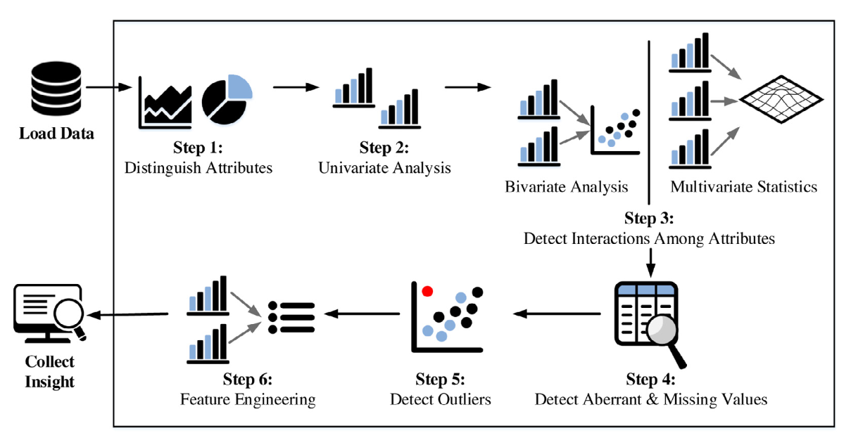
Exploratory Data Analysis
Exploratory data analysis (EDA) is used by data scientists to analyze and investigate data sets and summarize their main characteristics, often employing data visualization methods. In this, we look for the outliers present in the data

Slide 11
Major steps in Exploratory data analysis
Univariate analysis using histograms and boxplots
Bivariate analysis using Scatter plot matrix

Slide 12

Feature engineering

Slide 13
Data Transformation
Create an ML pipeline using scikit-learn to pre-process the training data.
The data we have in the dataset is all numerical. So, first we will check which columns have the missing data and act accordingly.

Slide 14

Model Building

Slide 15

Model Building
Stepwise regression is a process that helps determine which factors are important and which are not Important factors are kept to ensure that the linear model does its prediction based on factors that can help it produce the most accurate result.

Slide 16

Choosing the Supervised learning model for the project

Slide 17
Supervised Learning models
Linear Regression
Random Forest
Support Vector Machines

Slide 18
Pros and Cons of each Supervised learning model
SVM supports both linear and non-linear solutions using kernel trick.
SVM handles outliers better than LR.
Both LR and SVM perform well when the training data is less, and there are a large number of features.
Linear regression is a linear model, which means it works well. when the data has a linear shape. But, when the data has a non-linear shape, then a linear model cannot capture the non-linear features.
So, in this case, you can use the decision trees, which do a better job at capturing the non-linearity in the data by dividing the space into smaller sub-spaces.

Slide 19

Cross validation

Slide 20
Cross Validation techniques
The advantage of the LOOCV method is that we make use all data points reducing potential bias. However, the process is repeated as many times as there are data points, resulting in a higher execution time when n is extremely large. Additionally, we test the model performance against one data point at each iteration.
This is the simplest cross validation technique First re-train the chosen regression model using all of the provided training data and test your predictions on the provided example test data.
This approach leaves p data points out of training data, i.e. if there are n data points in the original sample then, n-p samples are used to train the model and p points are used as the validation set. This is repeated for all combinations in which the original sample can be separated this way, and then the error is averaged for all trials, to give overall effectiveness.

Slide 21
Conclusion
Till now, I have worked to obtained a 2-D array by removing all the outliers.
Random forest and Linear regression would be a ideal fit for this project.
Few insights after exploratory data analysis phase :
Target death rate increases (slightly) linearly with povertyPercent.
The correlations of all the features with respect to the target variable are medium and not so strong.
The top 5 features that have the highest correlation in comparision to other variables are PctBachDeg25_Over, incidencerate, PctPublicCoverageAlone, medIncome, povertyPercent.
PctBachDeg25_Over, medIncome are negatively correlated with target while the remaining variables are positively correlated.

Slide 22
References
Comparative study on machine learning algorithms
https://towardsdatascience.com/comparative-study-on-classic-machine-learning-algorithms-24f9ff6ab222#:~:text=When%20there%20are%20large%20number,are%20better%20than%20linear%20regression.
Cross Validation Techniques
https://towardsdatascience.com/cross-validation-in-machine-learning-72924a69872f
Step-wise linear Regression
https://towardsdatascience.com/stepwise-regression-tutorial-in-python-ebf7c782c922#:~:text=In%20simple%20terms%2C%20stepwise%20regression,the%20accuracy%20of%20our%20prediction.
GitHub References
ttps://github.com/shubham199408/Predicting-Cancer-mortality-rate-in-US-with-R#predicting-cancer-mortality-rate-in-us-county

Slide 23

THANK YOU

